Slide 1
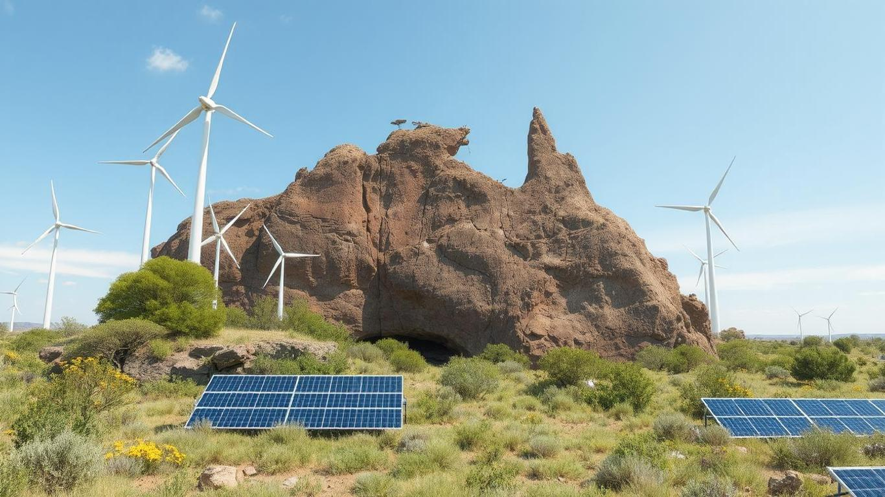

Is Australia on Track with Emissions?
Author | Anirban Chakrabarty
zlD | z5626947
Course | ZZBU6507-Data Visualization and Communication (H325 Online)
Tutorial Time | May - June 2025
Tutor | Dr. Khimji Vaghjiani
Date | 16/June/2025

Slide 2
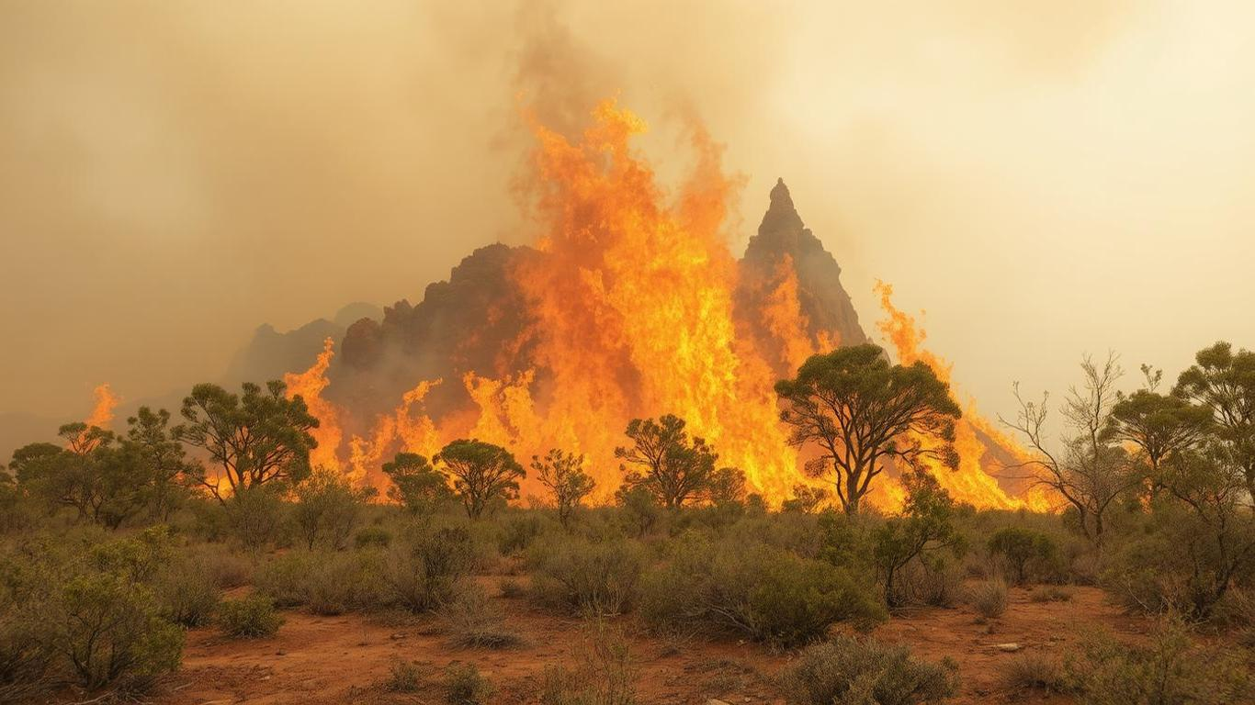

Slide 3
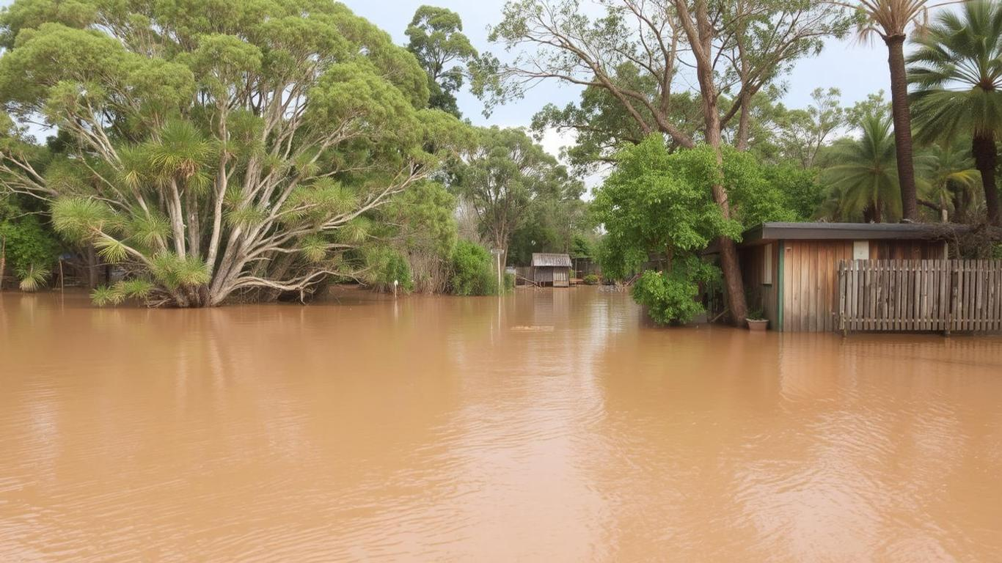

Slide 4


Slide 5


Slide 6
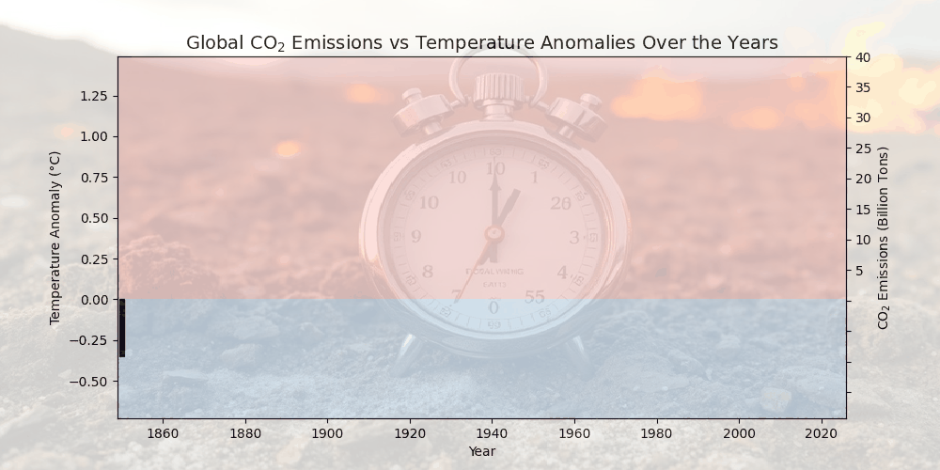

Slide 7

Paris Agreement (2015)
Primary Goal:
Limit global temperature rise to well below 2°C
Efforts to limit it to 1.5°C above pre-industrial levels
Other Key Aims:
Enhance adaptive capacity to climate impacts
Mobilize climate finance for developing countries.
Promote low-carbon development and global cooperation

Slide 8

Is Australia on Track with Emissions?
Small size, but large impact
Though just 0.3% of global population
Ranks among the top per-capita carbon emitters
Global leader in many fields including economy

Slide 9
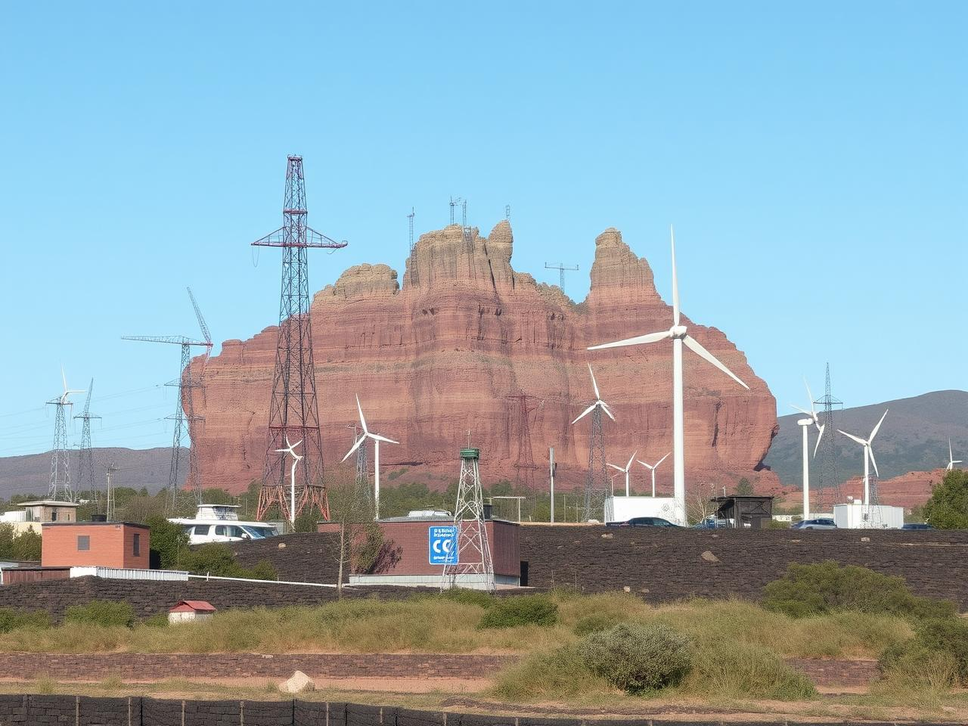
Australia’s Paris Agreement Targets
2030:
43% reduction in GHG emissions (from 2005 baseline)
82% renewable electricity generation
2050:
Net Zero GHG Emissions
Net Emission = Gross Emissions (from human activity) – Removals (e.g., carbon offsets, afforestation, carbon capture)

Slide 10
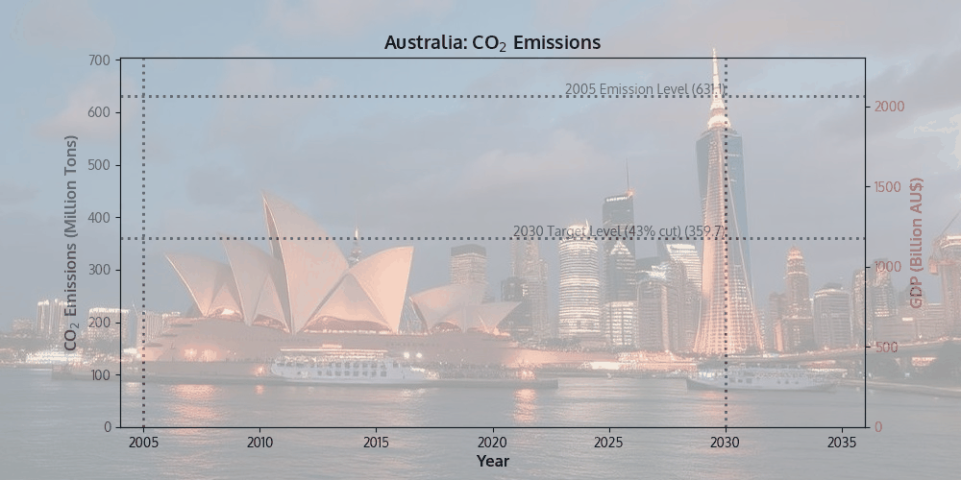

Slide 11
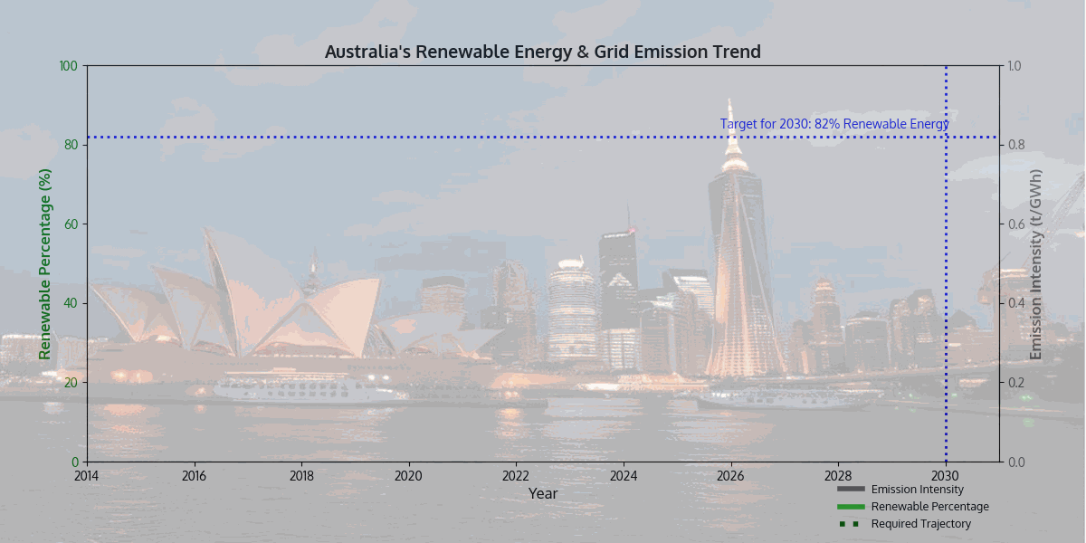

Slide 12
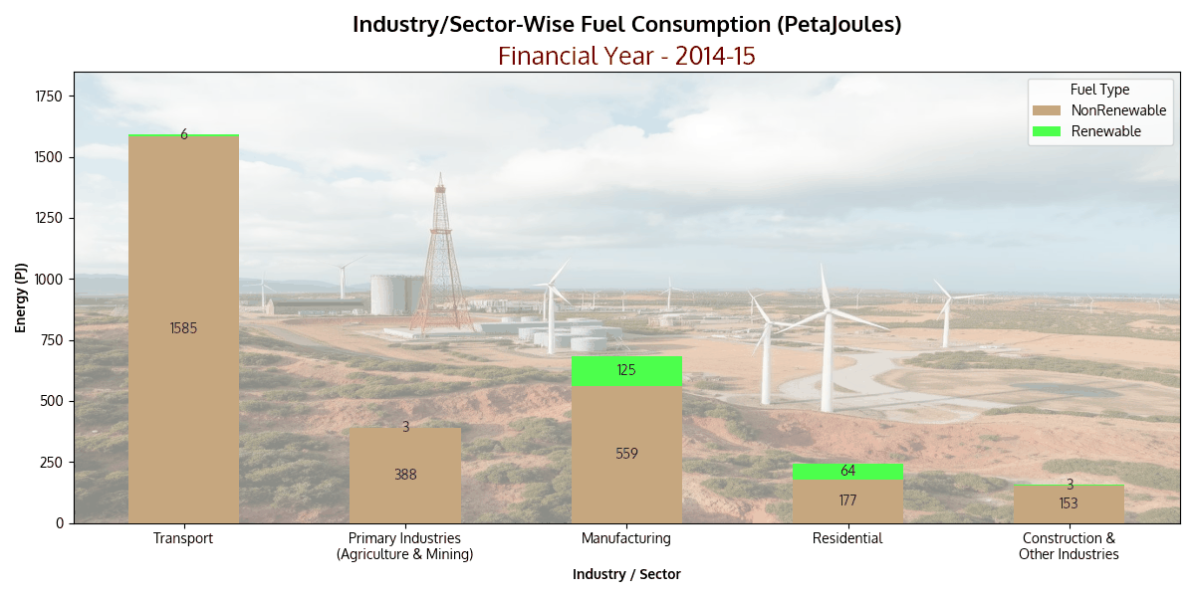

Slide 13
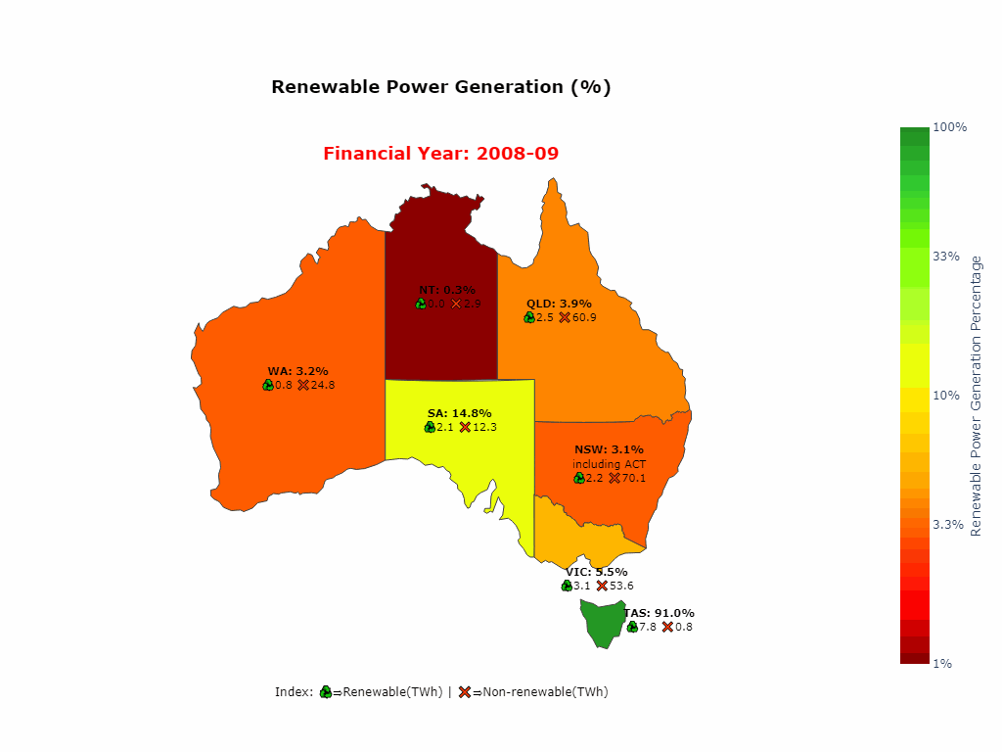

Slide 14
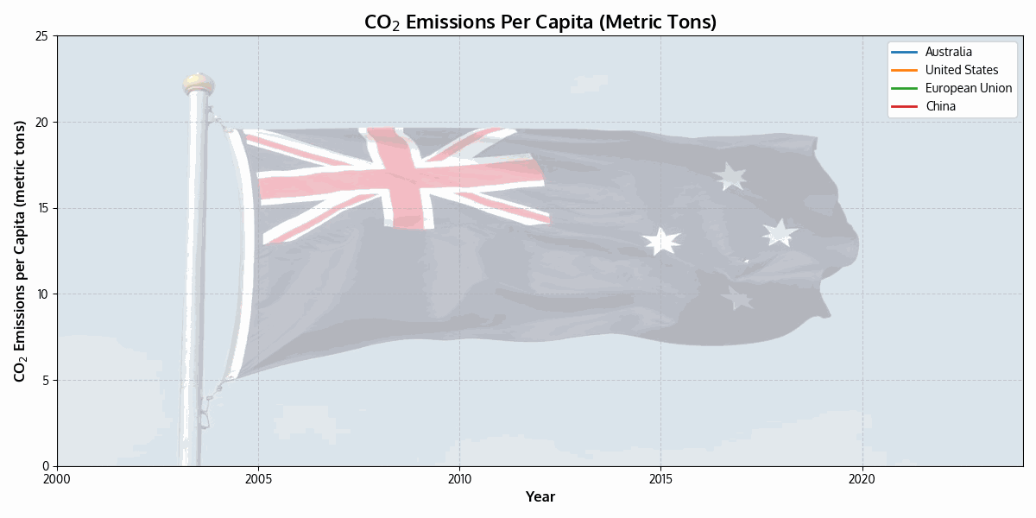

Slide 15
Australia's Climate Action Tracker Ratings (2024)
Overall Rating: Insufficient (< 3°C World)
Current policies are projected to lead to more than 3°C warming
Urgent need for stronger climate action to meet Paris Agreement targets
Policies & Action vs Domestic Pathways: Insufficient
2030 NDC Target vs Domestic Pathways: Insufficient
2030 NDC Target vs Fair Share: Insufficient
Climate Finance: Critically Insufficient

Slide 16

Individuals Can Lead Change
In November 2024, Rooftop PV celebrated a significant milestone:
Four million plus installations
Cumulative total capacity of 25.5 GW
Leading nation in per capita solar electricity generation
In 2023 ranked first with 1,774 kWh solar power per person
Ahead of United Arab Emirates and the Netherlands
More than 1 in 3 homes in South Australia have rooftop solar

Slide 17
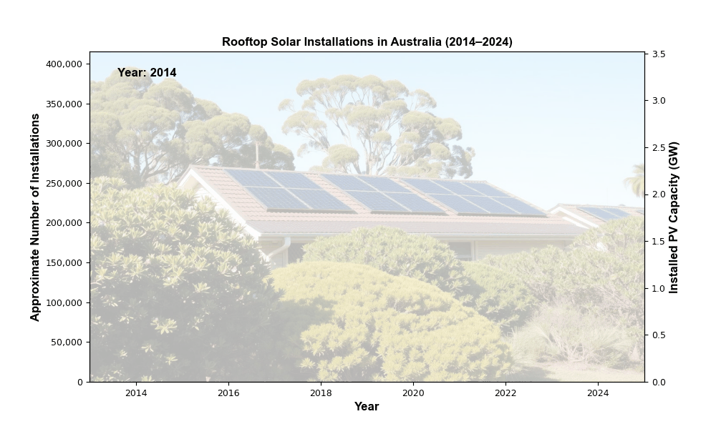

Slide 18
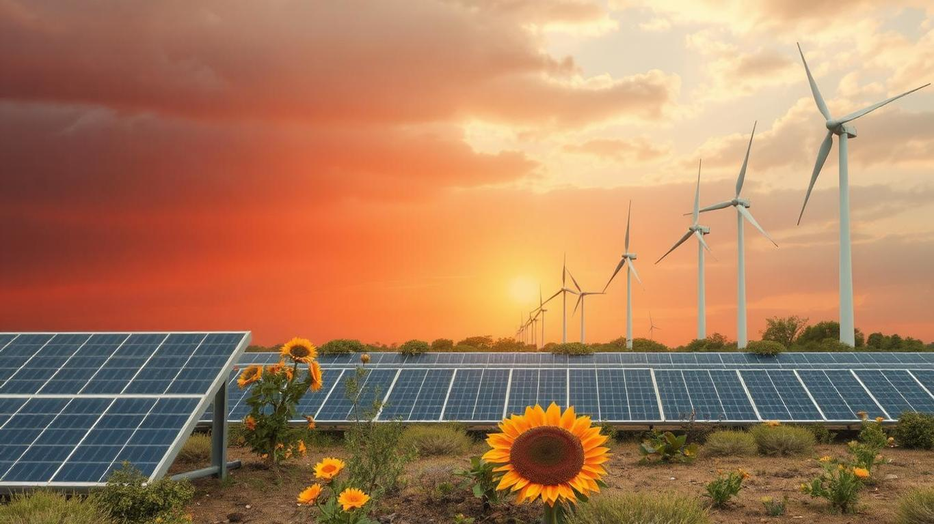
Achievements:
Decoupling economic growth from emissions
Boosting renewables
Deficiencies:
International climate action ratings "Insufficient"
Final Thoughts:
While individual efforts offer hope, urgent and ambitious policy changes are critical for Australia to accelerate progress and fulfill its global climate responsibilities

Slide 19
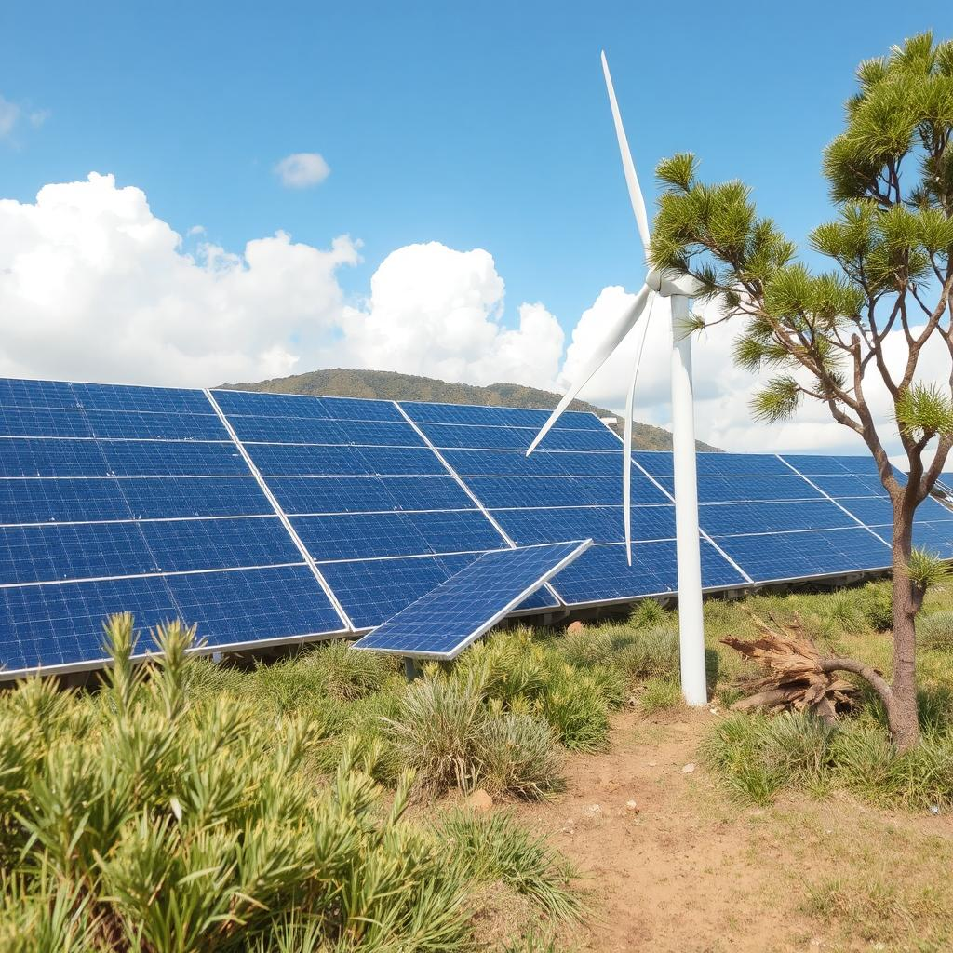
Reference | Data Source/ Hyperlink
Emissions trend vs 2030/2050 targets | greenhouseaccounts.climatechange.gov.au
Sectoral emissions breakdown | greenhouseaccounts.climatechange.gov.au
State-level renewable energy share | energy.gov.au
Rooftop solar uptake by state | cleanenergyregulator.gov.au
Emissions intensity of electricity | energy.gov.au
Current vs Required Emission Path | climateactiontracker.org
Global per capita comparison | ourworldindata.org
GitHub Python Data Visualization Codes | github.com/anodiamadmin/AIML/tree/main/04DataViz/A2c

